Slide 1
EDA of Wine Reviews
Prepared by
Vikas Ranjan
DSC-530 – Data Science, Bellevue University

Slide 2
Agenda
Abstract
Statistical or Hypothetical questions
Dataset Variables
Data Cleanup
Scatter Plot
Histogram
PMF (Need full form)
CDF (Need full form)
Prediction Analysis
Challenges and Conclusion
References

Slide 3
Statistical or Hypothetical questions
1. How price of a wine is related with the scores?
2. What is the points score of most of the US wines?
3. What is the points score of most of the French wines?
4. Comparing points of both US Wines and French, which ones have better scores?
5. Comparing prices of both US Wines and French, which ones are better priced?

Slide 4
Abstract
Wine, a much loved alcoholic drink has been produced and enjoyed since thousands of years. It is typically made from fermented grapes. Different varieties of grapes and strains of yeasts produce different styles of wine. This dataset consists of details of 129971 wines reviews produced across the globe by different wineries. We would be performing EDA on the wine reviews dataset by analyzing the variables in the dataset. We would be performing statistical functions to uncover some insights from the dataset.

Slide 5
Datasets Variables
Country
Description
Designation
Points
Price
Province
Region_1
Region_2
Taster_name
Taster_twitter_handle
Title
Variety
Winery Wine

Slide 6
Data Cleanup
This wine review dataset when loaded into a data frame has 14 columns and 129971 Rows. Below is the snapshot of missing data in the dataset:
There are 9 columns that have missing values.
There is 1 column having greater than 50% missing value.
There is 1 column having greater than 40% missing value.
There is 1 column having greater than 30% missing value.
There are 4 columns having greater than 20% missing value.
There are 5 columns having greater than 10% missing value.

Slide 7
Continuation . . .
Below is the snapshot for variable wise missing values.
 | Zero Values | Missing Values | % of Total Values
region_2 | 0 | 79460 | 61.1
designation | 0 | 37465 | 28.8
taster_twitter_handle | 0 | 31213 | 24
taster_name | 0 | 26244 | 20.2
region_1 | 0 | 21247 | 16.3
price | 0 | 8996 | 6.9
country | 0 | 63 | 0
province | 0 | 63 | 0
variety | 0 | 1 | 0

Slide 8
Continuation . . .
There are duplicates in the description field, therefore we need to remove them.
First variable “"Unnamed: 0” in the data frame is just the serial #, therefore it is safe to remove them as there is no benefit of it to provide insight about data.
We also need to remove the region2 from data frame since majority of it is not having any value.
We also need to null values from the dataframe.
There are 47660 rows and 11 columns, after all the cleanup and removing all rows with null values.

Slide 9
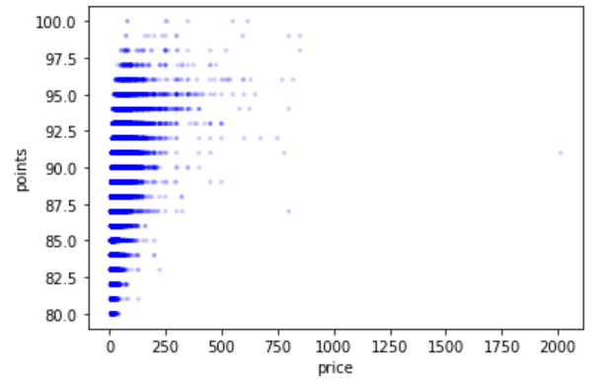
Scatter Plot
Scatter Plot of price and points of the wines.

Slide 10
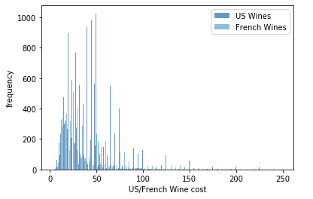
Histogram
Histogram of wine scores/price and comparison of US and French wines.

Slide 11
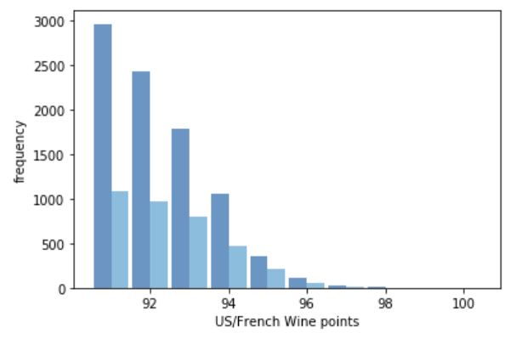
Continuation . . .

Slide 12
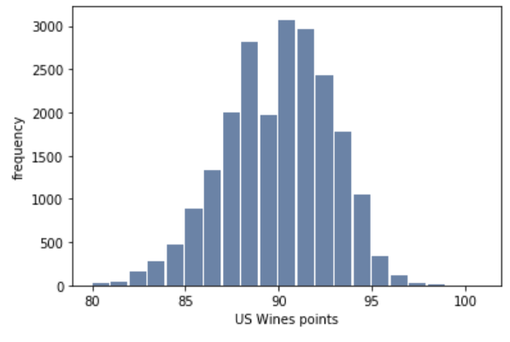
Continuation . . .
Eliminating the outliers in the dataset, created data frames for US Wines and French wines which are priced less than 250. Below histogram suggests that most of the US Wines are having a score of 91.

Slide 13
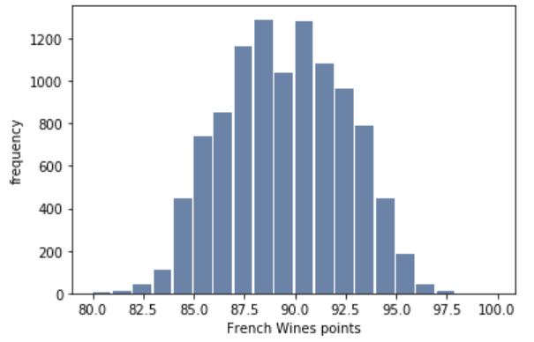
Continuation . . .
Below histogram suggests that most of the French wines are having a score of 88.5.

Slide 14
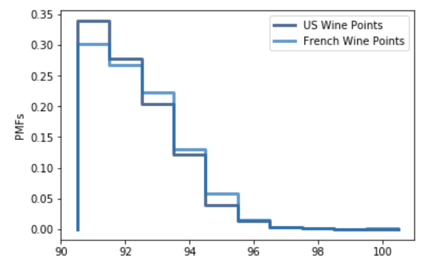
PMF
PMF of wine scores.

Slide 15
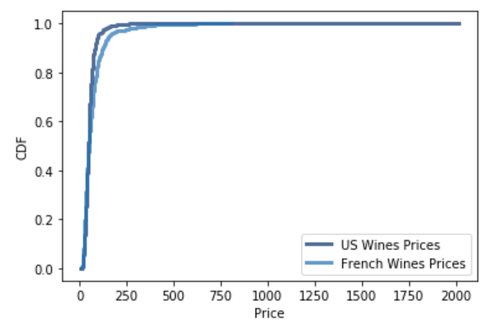
CDF
CDF of price between US and French wines which have score greater than 90.

Slide 16
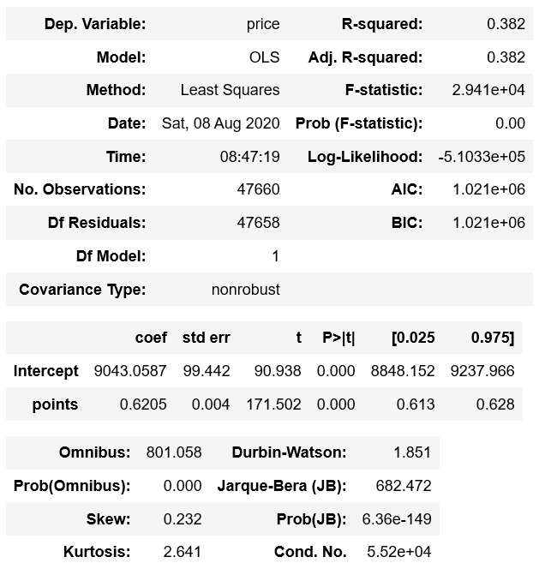
Prediction Analysis
Created a model to predict the price of the wine based on the score of the wine. And based on it, tried to predict what might be the price of a wine which has a score of 97.

Slide 17
Challenges and Conclusion
After proceeding far along in this final assignment, I felt I should have chosen a dataset with more numeric variables. One of the biggest challenge I faced was that I only had 2 numeric variables (price and points) to play with. When I looked that this dataset, I made an assumption that French wines are expensive since they are better. However after performing the EDA, I noticed that US wines on an average are cheaper than French wines when compared with the ones with similar score.

Slide 18
References
Downey, A. (2015). Think stats: Exploratory data analysis.
AllenDowney. (n.d.). AllenDowney/ThinkStats2. Retrieved August 09, 2020, from https://github.com/AllenDowney/ThinkStats2

Slide 19
Thank You!

